Slide 1

Training for
Employees
Professional
Development
Tool
ISSC AS Competency
2006 May
Notes:
Welcome to the overview of Professional Development Tool for employees.

Slide 2
Agenda
PD tool linkage
How to register your profile
---First time to PD tool, requested action for new PD tool user
How to assess your skillmaps
---Requested action, very important
How to view your profile
---Optional function,
How to view approval status
---Requested action, very important for you to track your assessment status
How to Edit your profile
---Optional function, if no need change your profile, then you can skip this part
How to Edit your Job roles
---Optional function, if no need change your Job roles, then you can skip this part
Assessment Measurement
Attachment -- ISSC JRSS Job roles Short list
FQA

Slide 3
How to Access PD tool
http://w3.ibm.com/services/competencies/profdev

Slide 4
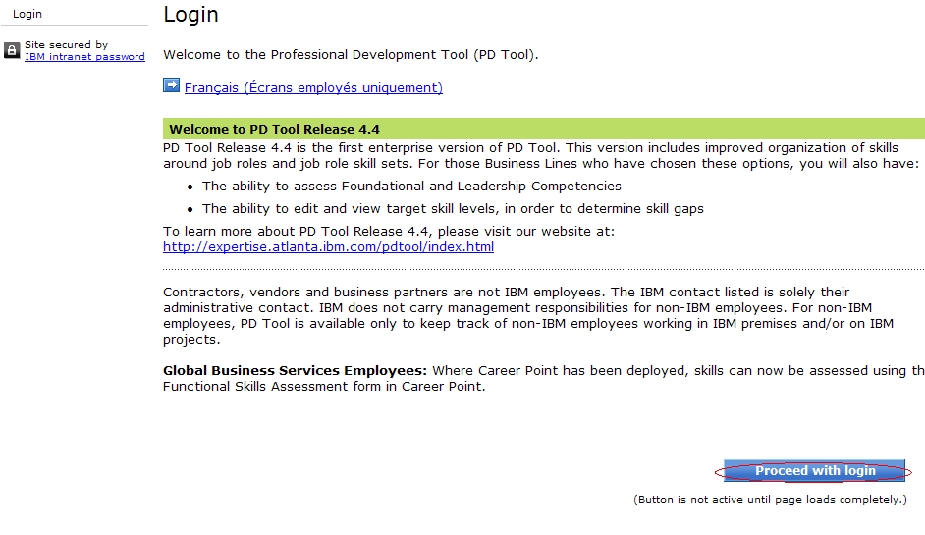
Notes:
To fully use the Professional Development Tool, you must be registered. Your manager might have completed your registration. If not, when you login to the tool for the first time, you are prompted to self-register.

Slide 5
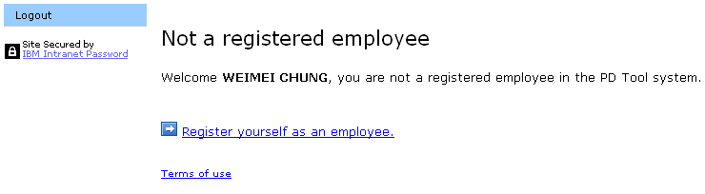
Register-this part is for new PD tool user, first time login
Notes:
If you are not registered in the system, you are prompted to do so. Click the Register yourself as an employee link to begin.

Slide 6
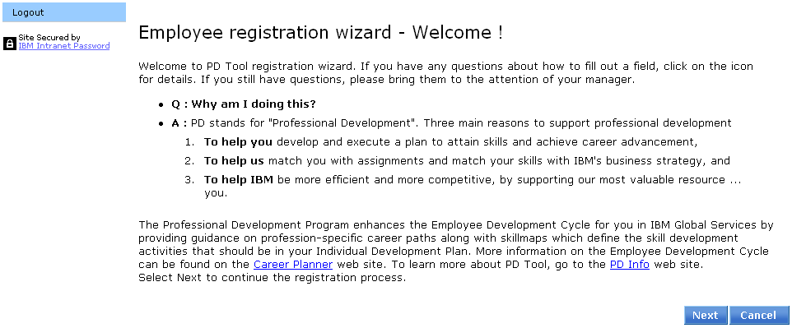
Notes:
The Professional Development Program enhances your Employee Development Cycle by providing guidance on profession-specific career paths, along with skillmaps, which define development activities for you. Once you are comfortable with what PD Tool is about, click Next to begin the registration process.

Slide 7
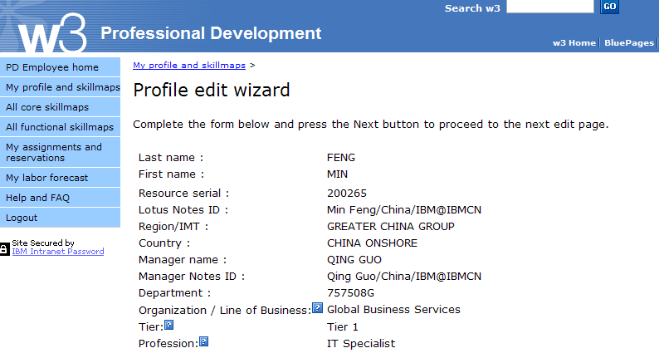
9X9999
Global Business Services should be selected
Tier A for Band 90
Tier 1 for Band 6 & 7 Tier 2 for Band 8 & 9 Tier 3 for Band 10 & Up
Notes:
Your employee information is shown on the screen, and you are prompted to select your line of business or organization, tier, and profession before proceeding with your registration.
you belong.
Your line of business is the business line or organization to which
The tier denotes the degrees of skill development that build upon one another, as follows:
Tiers are loosely related to bands, but the correlation depends on geography. For example, in the Americas, bands 6 and 7 are usually Tier 1, bands 8 and 9 are Tier 2, and bands 10 and higher are Tier 3. Tier 4 is currently a placeholder.
The tier in which an employee is placed determines the core skillmaps that are added to that employee’s profile.
The Profession field is used for those employees who are working toward or who have achieved certification in an IBM-defined profession.

Slide 8
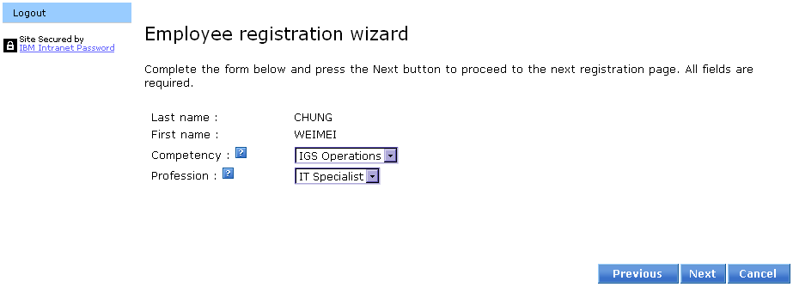
Notes:
Now select your competency and profession, and click the Next button to continue. There might be other questions to answer based on the specific line of business or organization and profession that you chose on the previous page.

Slide 9
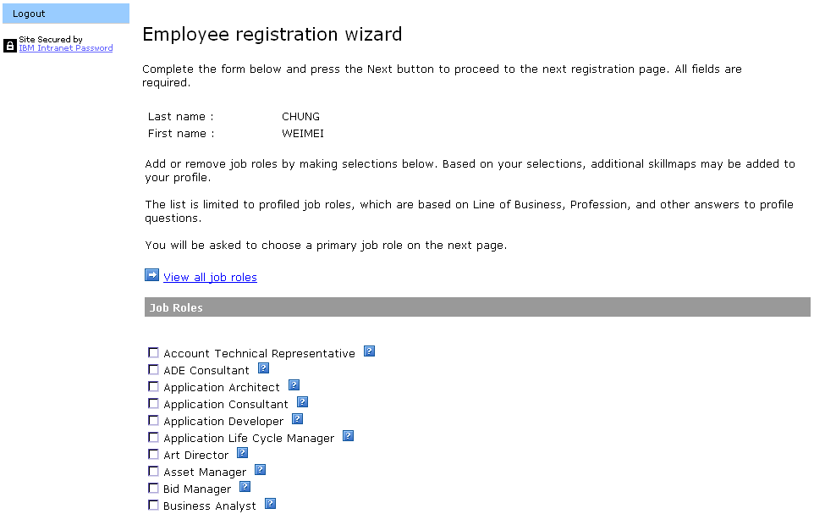
Notes:
Job roles can be added and removed by clicking the checkboxes. Selecting new job roles may add additional functional skillmaps to your profile. Skillmaps will not be automatically deleted if you remove a job role.
When finished adding or removing job roles, click the Next button at the bottom of the screen.

Slide 10
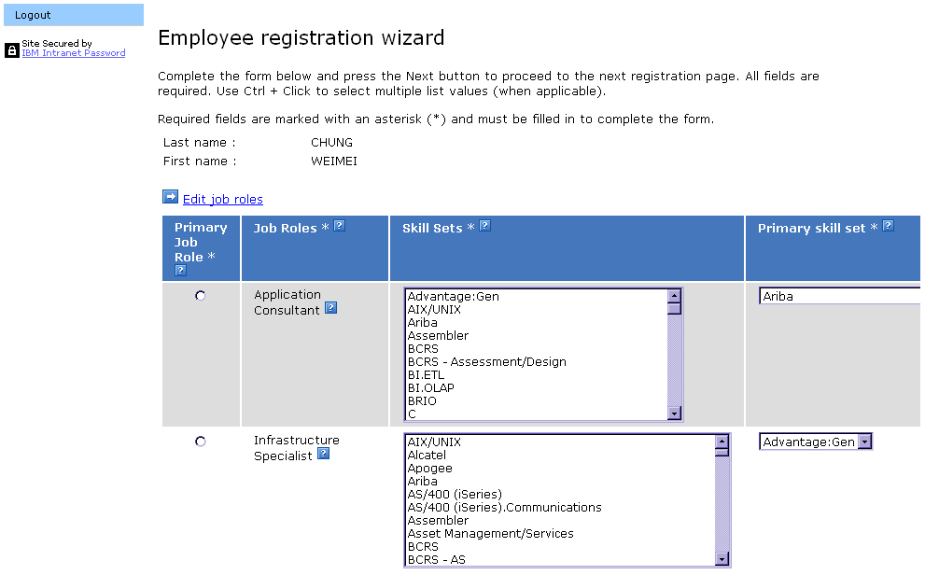
Notes:
On this screen, select your primary job role and the job role skill sets that are associated with your primary and additional job roles. To add or remove job roles, click the Edit job roles link at the top of the screen. Note that some organizations only allow managers to change the primary job role after registration is complete.
In the Primary job role column, click the radio button to the left of the title that represents your primary job role. Only one primary job role can be selected.
Job role skill sets identify the specialization that you have within the job roles. For each job role in your profile, select the job role skill sets associated with that job role in the Skill sets column. To select multiple job role skill sets, press and hold the Control key while clicking the job role skills sets you want to add. If you do not have a specialization, then select Unspecified.
Next, select the one job role skill set that is primary for that job role by clicking that job role skill set from the drop-down list in the Primary skill set column.
Click the Next button to continue.

Slide 11
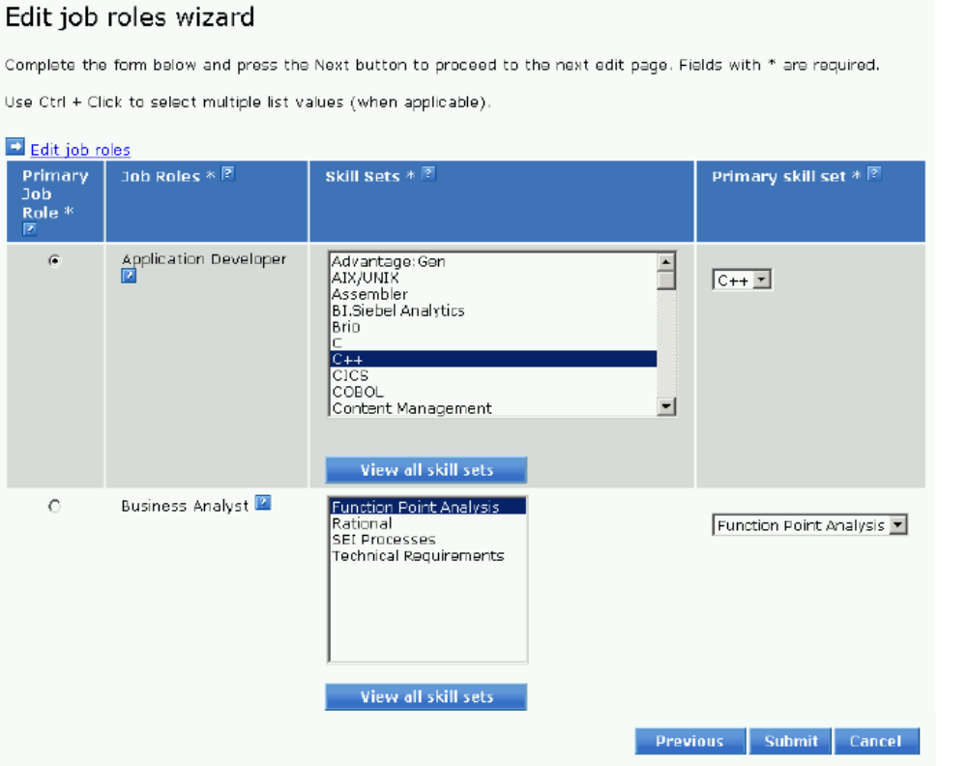
Notes:
On this screen, select your primary job role and the job role skill sets that are associated with your primary and additional job roles. To add or remove job roles, click the Edit job roles link at the top of the screen. Note that some organizations only allow managers to change the primary job role after registration is complete.
In the Primary job role column, click the radio button to the left of the title that represents your primary job role. Only one primary job role can be selected.
Job role skill sets identify the specialization that you have within the job roles. For each job role in your profile, select the job role skill sets associated with that job role in the Skill sets column. To select multiple job role skill sets, press and hold the Control key while clicking the job role skills sets you want to add. If you do not have a specialization, then select Unspecified.
Next, select the one job role skill set that is primary for that job role by clicking that job role skill set from the drop-down list in the Primary skill set column.
Click the Next button to continue.

Slide 12
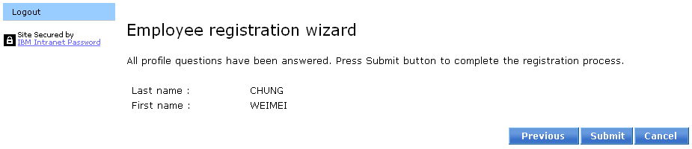
Notes:
When the registration requirements are complete, you can submit your registration.

Slide 13
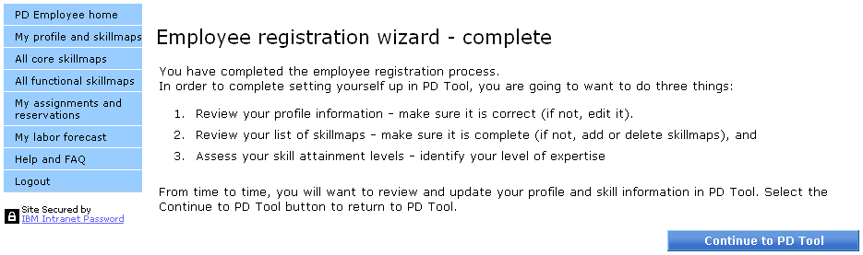
Notes:
A prompt will appear on screen, outlining the next three steps for you to take. They are:
Review your profile information, and make any necessary changes.
Review your list of skillmaps.
Assess your skill attainment levels.
Once complete, click Continue to PD Tool.
Note: The information you provide to the Professional Development Tool from time to time will be used for professional development and resource management purposes, and will be processed in accordance with IBM's Guidelines for the Protection of Employee Information. It will be stored in a secure IBM database and will be accessible only by you, your manager, and other authorized personnel who have a need-to-know in connection with the above purposes. Skill information in PD Tool will be exchanged with information in the Skills Information Warehouse (Skills-IW) to ensure consistency. You may access and/or amend your information by using the PD Tool.

Slide 14
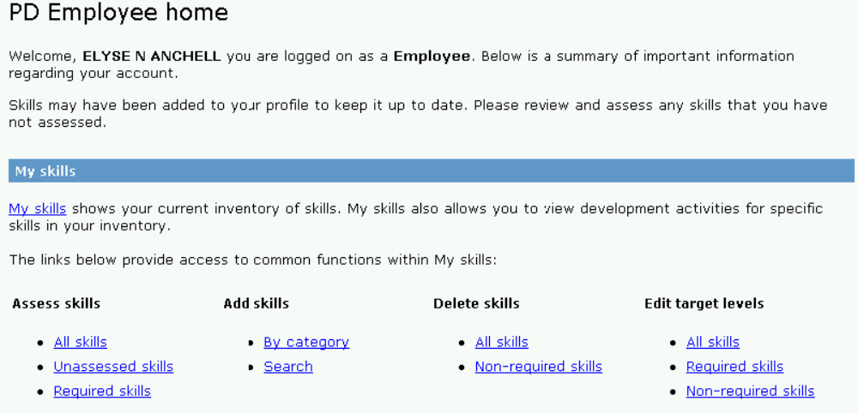
Assess your skillmaps
Notes:
After you have registered in PD Tool, you will use the tool most frequently to assess your skills. Use the Assess all skillmaps link on “PD Employee home” page to begin this process.

Slide 15
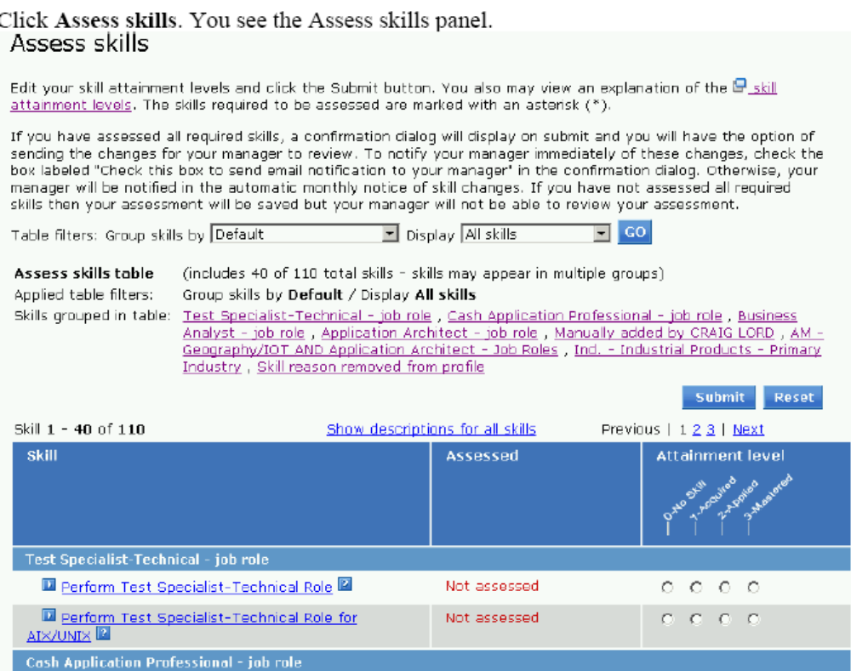
Notes:
Only the active skill maps display on the first set of assessment pages. To update a skillmap attainment level, select the appropriate level for each skill. When complete, select the Update button at the bottom of the page. If all active skillmaps have been assessed and there are no changes to the existing assessment since the last time that you visited the PD Tool, then click the No Changes button instead.

Slide 16
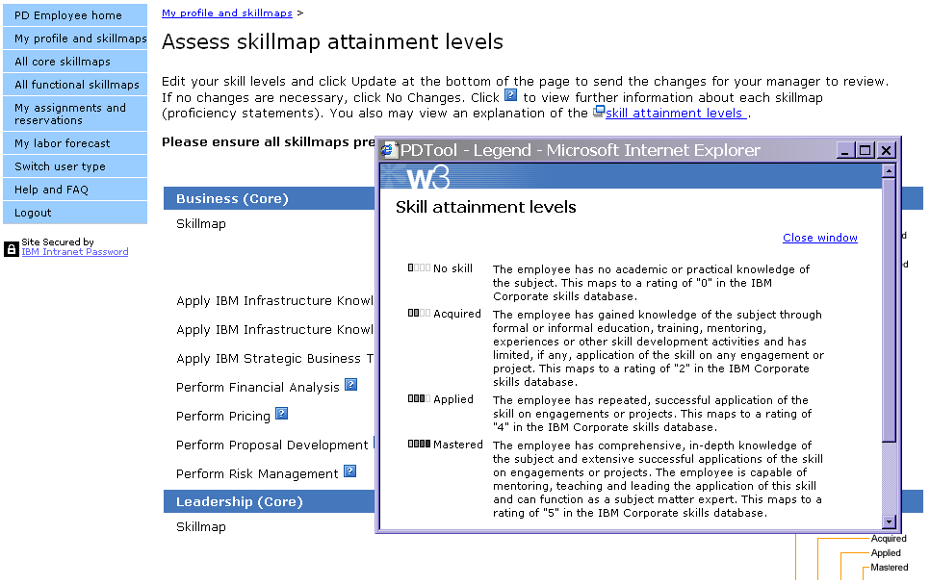
Notes:
Click the Skill attainment levels link at the top of the page to view an explanation of the skill attainment levels.
To finalize the changes to your skill attainment levels, click the Update button at the bottom of the page. A confirmation screen is displayed.
Optionally, a note is sent to your manager or designated reviewer asking for an approval of the updates. We recommend that you do send a note to your manager or designated reviewer to proactively remind them to validate your skills. But notify your manager only when you have completed all of your updates, not after each individual update.
After you have completed assessing your skills, click the Exit assessment link at the bottom of the screen, which returns you to the “PD Employee home” page.

Slide 17
Assess only unassessed skillmaps
If you didn’t complete your skill maps assessment last time, please select only unassessed skillmap to complete it
Notes:
After you have registered in PD Tool, you will use the tool most frequently to assess your skills. Use the Assess all skillmaps link on “PD Employee home” page to begin this process.

Slide 18
View Your Profile for more details
Notes:
After you have registered in PD Tool, you will use the tool most frequently to assess your skills. Use the Assess all skillmaps link on “PD Employee home” page to begin this process.

Slide 19
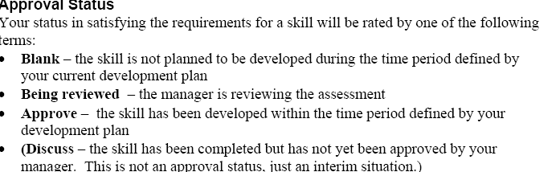
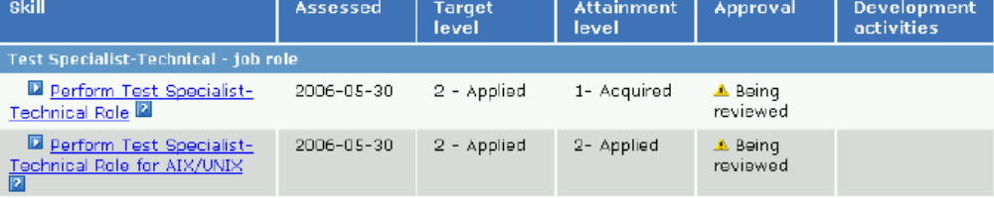
View your assessment status
Please check whether the approval status is ‘agree’, if no please contact your manager as soon as possible to make all your assessment approved
Notes:
Attainment of core skills is needed for tier advancement. The core skills are divided into three areas: Business, Leadership, and Relationship.
In the Status column:
“In progress” means there is at least one planned skill development activity for the skill.
“Attention” means there is at least one planned skill development activity for the skill that should have been completed by today’s date. The planned completion date has already passed.
“Complete” means all skill development activities that have planned completion dates have been completed.
“No plan data” means there are no planned skill development activities for this skill.
“Assess only” means there are no skill development activities available for this skill.
The Attainment column shows the last approved attainment level.
In the Approval column:
“Agree” means the skill attainment level has been approved by the manager.
“Discuss” means the manager wants to talk to the employee about the skill attainment level.
“Pending” means the employee has changed the skill attainment level, but the manager has not yet approved it.
Your manager might identify a designated reviewer who can also review skills and update status to “Approve” or “Discuss.”
Some lines of business or organizations might assess core skills outside of PD Tool using Career Point. The information is then fed back to PD Tool on a regular basis. For employees in these lines of business or organizations, for these items, the employee should focus only on skill development activities in PD Tool and not assess attainment levels in PD Tool.

Slide 20
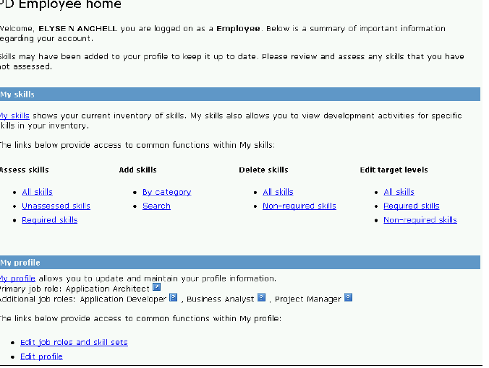
View your profile information-click Edit profile to edit, after you updated your information, please select notify your manager

Slide 21
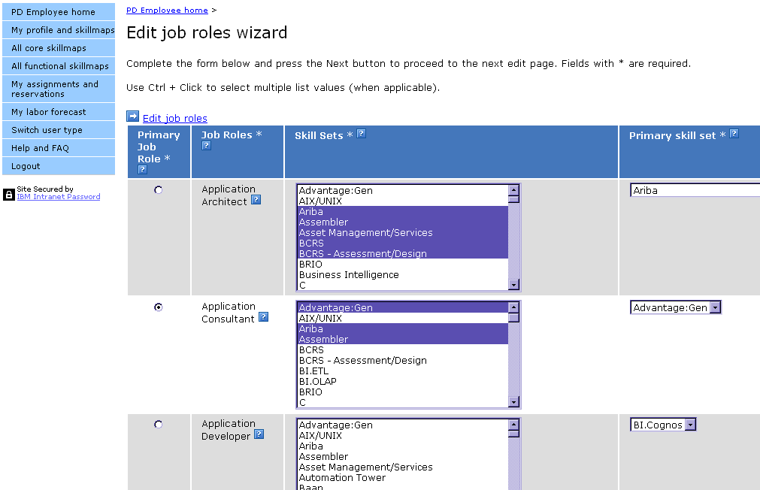
Notes:
On the “Edit job roles wizard” screen, select your primary job role and the job role skill sets that are associated with your primary and additional job roles. To add or remove job roles, click the Edit job roles link at the top of the screen. Note that some organizations only allow managers to change the primary job role after registration is complete.
In the Primary job role column, click the radio button to the left of the title that represents your primary job role. Only one primary job role can be selected.
Job role skill sets identify the specialization that you have within the job roles. For each job role in your profile, select the job role skill sets associated with that job role in the Skill sets column. To select multiple job role skill sets, press and hold the Control key while clicking the job role skills sets you want to add. If you do not have a specialization, then select Unspecified.
Next, select the one job role skill set that is primary for that job role by clicking that job role skill set from the drop-down list in the Primary skill set column.
To continue, click the Submit button at the bottom of the screen.

Slide 22
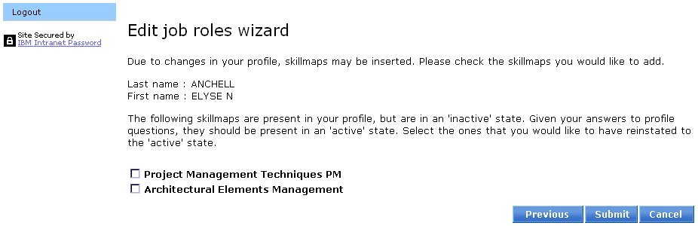
Notes:
If you have made changes to your profile, skillmaps may need to be reactivated. You can make skillmaps active by checking the corresponding boxes next to the ones you want activated. Once complete, select the Submit button. To amend previous choices, click the Previous button.

Slide 23
The measurement of PD tool completion
1. Assessment completion criteria:
1) Assessed skills >= 50% of total skills suggested by PD tool
2) All assessed skills have been approved by Manager
3) Must update every 6 months
2. While your read the report, please check the monthly R19 report column AB1 of attachment-1 and AC of attachment-2(Assessment Status) comparing the below description, to identify what action you need take:
1) 'No Action'--- Haven't done any assessment! Need employee action at once!
2) 'Assessment Started' --- The number of assessed skills are less than 50% of the total skills. Need employee action at once!
3) 'Pending Manager Approval' --- Number of assessed skills are more than 50% but haven't got manager's approval. Need manager action at once!

Slide 24
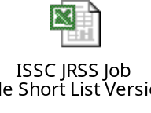
Attachment -- ISSC JRSS Job roles Short list for your reference
The ISSC JRSS job short list is recommended from RDM team, for your reference here, should you have any question
on this job short list ,please consultant RDM team directly.

Slide 25
FQA
1.Q:If I meet ‘access denied’ error, how can I do?
A: Please ask your manager’s help to load your EMF information to PD tool.
2.Q:Why I cannot change my job role?
A: The personal information is very important, such as organization, some of organization
such as BCS is not allowed to change the job role by employee themselves.
You have to get help from your manager.

Slide 26
FQA
3.Q:I’m an new employee, when shall I complete my PD tool assessment?
A: 2 weeks after you are on board.
4.Q:When shall I update my PD tool
A: Coz many trainings are conducting timely, the employees’ skill level must be improved with the time goes on, competency team request the employees to update their PD tool assessment every 3 monthly.
5.Q:If I meet some problem on my PD tool, from who can I get help ?
A: Your PDM will guide you how to complete your PD tool. First line help is from your PDM and the second line advisor is competency skill team.

